Slide 1
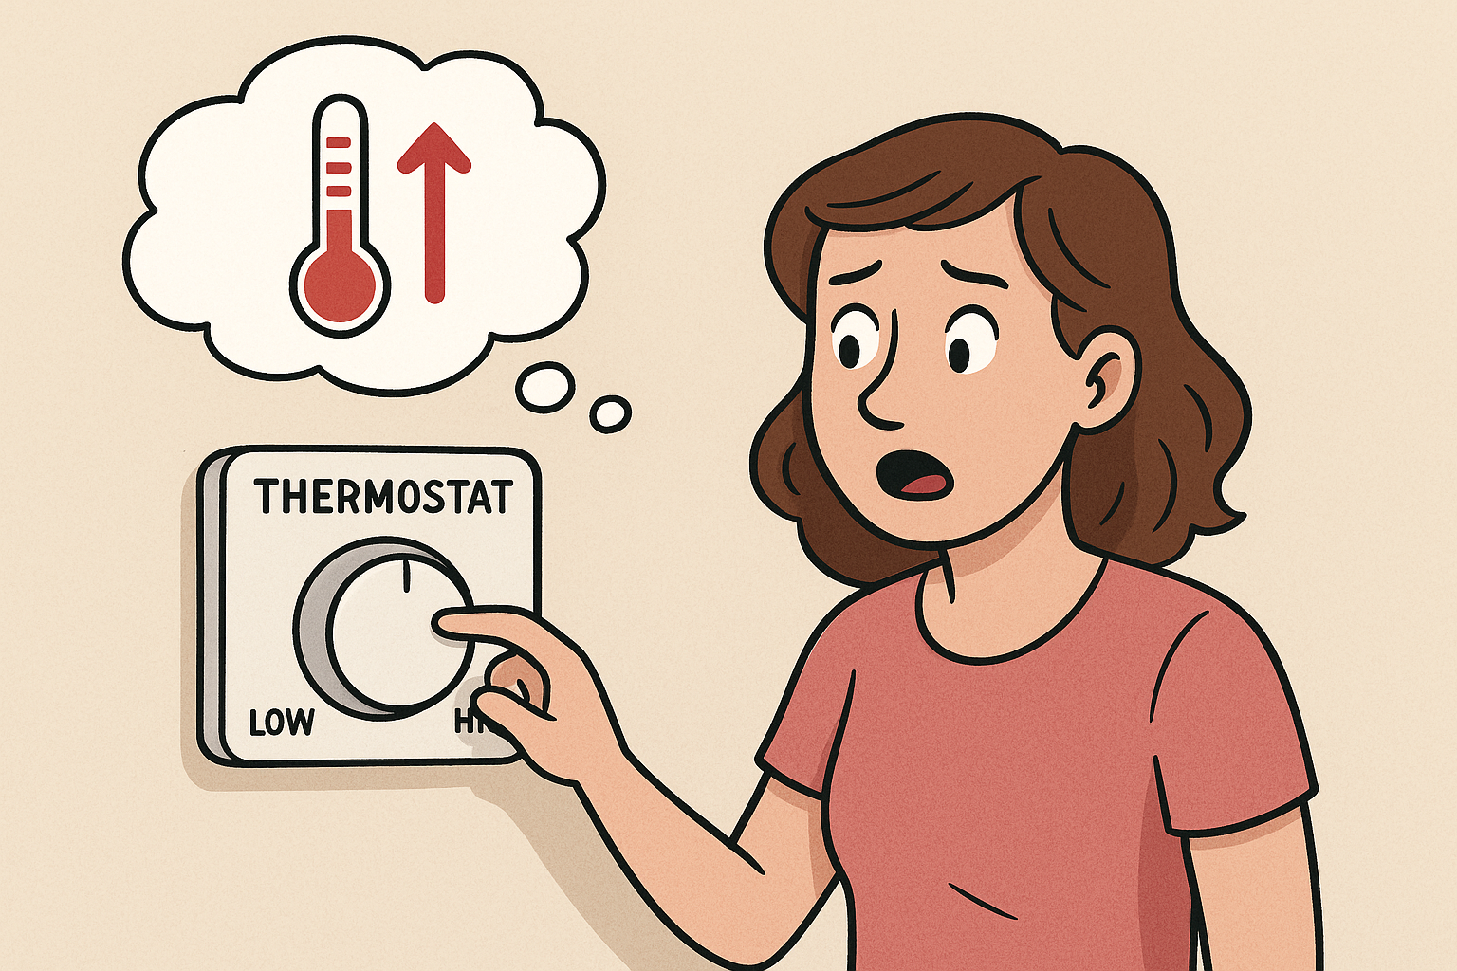
Mental Models
Notes:
Attention: How a person directs attention when acquiring and processing information has a fundamental impact on SA
May be affected by:
Operator experience
Operator understanding of the system
Physical characteristics of the environment
Perception
A critical component of SA
Detection, identification and recognition
May be affected by:
Experience and expectations
Long term memory (e.g. expert behaviour)
NB errors at perceptual level are common
Memory
Limits of working memory pose a constraint on SA
Strategies used by operators to reduce the working memory load include (Durso and Gronlund, 1999):
Use of meaningful chunks,
Information prioritisation
‘gistification’ of information
There is a correlation between LTM and SA at expert level
Experienced operators develop internal models of the systems they operate and of the environments in which they operate
Workload: interrelated, independent: high/high; high low; low low; low high
Measurement:
Process indices; subjective techniques; questionnaires; behavioural measures; performance measures

Slide 2

Thermostat Example
Temperature: 12*C Target: /
Notes:
Attention: How a person directs attention when acquiring and processing information has a fundamental impact on SA
May be affected by:
Operator experience
Operator understanding of the system
Physical characteristics of the environment
Perception
A critical component of SA
Detection, identification and recognition
May be affected by:
Experience and expectations
Long term memory (e.g. expert behaviour)
NB errors at perceptual level are common
Memory
Limits of working memory pose a constraint on SA
Strategies used by operators to reduce the working memory load include (Durso and Gronlund, 1999):
Use of meaningful chunks,
Information prioritisation
‘gistification’ of information
There is a correlation between LTM and SA at expert level
Experienced operators develop internal models of the systems they operate and of the environments in which they operate
Workload: interrelated, independent: high/high; high low; low low; low high
Measurement:
Process indices; subjective techniques; questionnaires; behavioural measures; performance measures

Slide 3
Thermostat Expectation 1
Temperature: 16*C Target: 20*C
Notes:
Attention: How a person directs attention when acquiring and processing information has a fundamental impact on SA
May be affected by:
Operator experience
Operator understanding of the system
Physical characteristics of the environment
Perception
A critical component of SA
Detection, identification and recognition
May be affected by:
Experience and expectations
Long term memory (e.g. expert behaviour)
NB errors at perceptual level are common
Memory
Limits of working memory pose a constraint on SA
Strategies used by operators to reduce the working memory load include (Durso and Gronlund, 1999):
Use of meaningful chunks,
Information prioritisation
‘gistification’ of information
There is a correlation between LTM and SA at expert level
Experienced operators develop internal models of the systems they operate and of the environments in which they operate
Workload: interrelated, independent: high/high; high low; low low; low high
Measurement:
Process indices; subjective techniques; questionnaires; behavioural measures; performance measures

Slide 4
Thermostat Expectation 2
Temperature: 16*C Target: 27*C
Notes:
Attention: How a person directs attention when acquiring and processing information has a fundamental impact on SA
May be affected by:
Operator experience
Operator understanding of the system
Physical characteristics of the environment
Perception
A critical component of SA
Detection, identification and recognition
May be affected by:
Experience and expectations
Long term memory (e.g. expert behaviour)
NB errors at perceptual level are common
Memory
Limits of working memory pose a constraint on SA
Strategies used by operators to reduce the working memory load include (Durso and Gronlund, 1999):
Use of meaningful chunks,
Information prioritisation
‘gistification’ of information
There is a correlation between LTM and SA at expert level
Experienced operators develop internal models of the systems they operate and of the environments in which they operate
Workload: interrelated, independent: high/high; high low; low low; low high
Measurement:
Process indices; subjective techniques; questionnaires; behavioural measures; performance measures

Slide 5
Thermostat Reality 1
Temperature: 24*C Target: 27*C
Notes:
Attention: How a person directs attention when acquiring and processing information has a fundamental impact on SA
May be affected by:
Operator experience
Operator understanding of the system
Physical characteristics of the environment
Perception
A critical component of SA
Detection, identification and recognition
May be affected by:
Experience and expectations
Long term memory (e.g. expert behaviour)
NB errors at perceptual level are common
Memory
Limits of working memory pose a constraint on SA
Strategies used by operators to reduce the working memory load include (Durso and Gronlund, 1999):
Use of meaningful chunks,
Information prioritisation
‘gistification’ of information
There is a correlation between LTM and SA at expert level
Experienced operators develop internal models of the systems they operate and of the environments in which they operate
Workload: interrelated, independent: high/high; high low; low low; low high
Measurement:
Process indices; subjective techniques; questionnaires; behavioural measures; performance measures

Slide 6
Thermostat Reality
Temperature: 27*C Target: 27*C
Notes:
Attention: How a person directs attention when acquiring and processing information has a fundamental impact on SA
May be affected by:
Operator experience
Operator understanding of the system
Physical characteristics of the environment
Perception
A critical component of SA
Detection, identification and recognition
May be affected by:
Experience and expectations
Long term memory (e.g. expert behaviour)
NB errors at perceptual level are common
Memory
Limits of working memory pose a constraint on SA
Strategies used by operators to reduce the working memory load include (Durso and Gronlund, 1999):
Use of meaningful chunks,
Information prioritisation
‘gistification’ of information
There is a correlation between LTM and SA at expert level
Experienced operators develop internal models of the systems they operate and of the environments in which they operate
Workload: interrelated, independent: high/high; high low; low low; low high
Measurement:
Process indices; subjective techniques; questionnaires; behavioural measures; performance measures

Slide 7
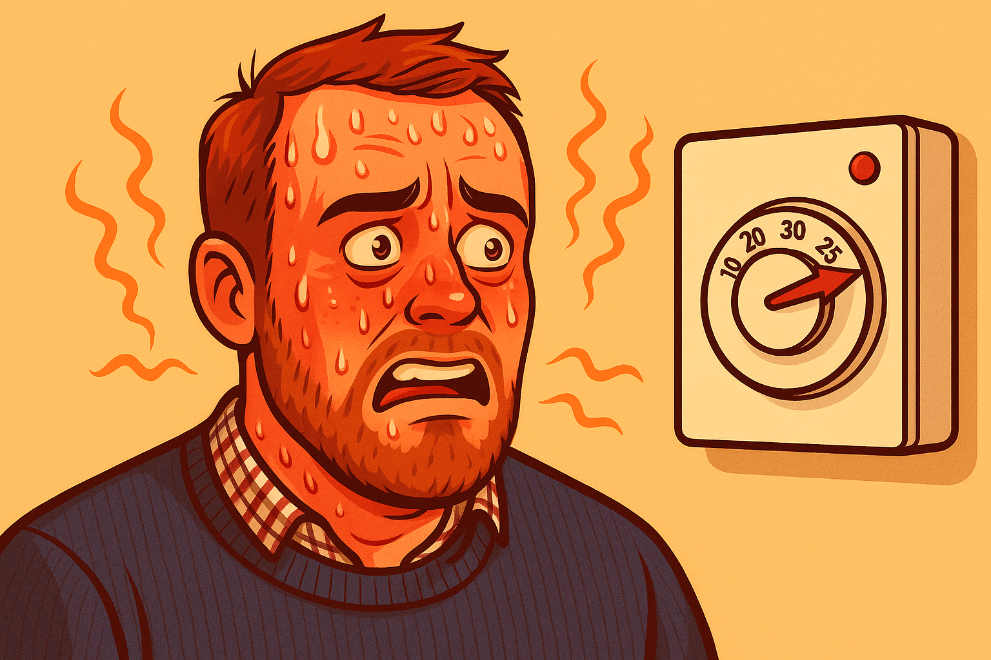
Thermostat Reality
Temperature: 27*C Target: 27*C
Notes:
Attention: How a person directs attention when acquiring and processing information has a fundamental impact on SA
May be affected by:
Operator experience
Operator understanding of the system
Physical characteristics of the environment
Perception
A critical component of SA
Detection, identification and recognition
May be affected by:
Experience and expectations
Long term memory (e.g. expert behaviour)
NB errors at perceptual level are common
Memory
Limits of working memory pose a constraint on SA
Strategies used by operators to reduce the working memory load include (Durso and Gronlund, 1999):
Use of meaningful chunks,
Information prioritisation
‘gistification’ of information
There is a correlation between LTM and SA at expert level
Experienced operators develop internal models of the systems they operate and of the environments in which they operate
Workload: interrelated, independent: high/high; high low; low low; low high
Measurement:
Process indices; subjective techniques; questionnaires; behavioural measures; performance measures

Slide 8
MMME4054 Week 5 – Mental Models
Dr Kyle Harrington

Slide 9
Recap
What did you learn last week?
Notes:
Attention and workload

Slide 10
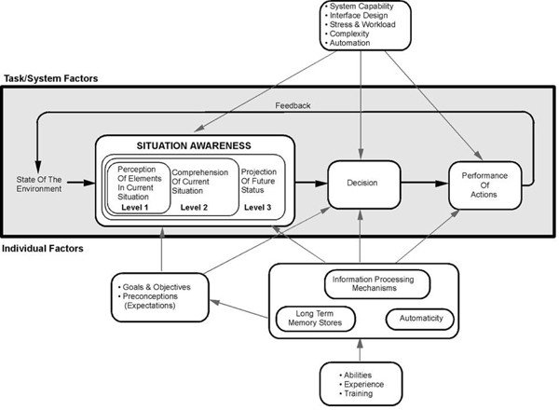
Situation Awareness Theory – Endsley’s model
Image source: Endsley, M.R., 1995. Toward a theory of situation awareness in dynamic systems. Human factors, 37(1), pp.32-64.

Slide 11

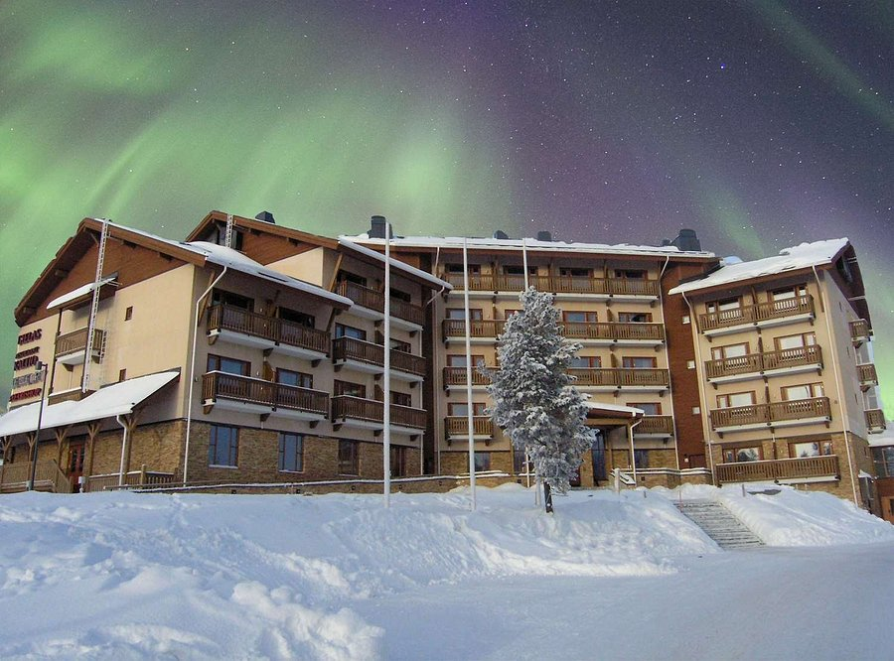
Situation awareness
Factors related to SA:
Attention
Perception
Memory
Workload
Is SA a folk model?
Situation awareness measures, including:
SAGAT
SART
Image taken from: SANTA'S HOTEL TUNTURI - Updated 2022 (Saariselka, Finland - Lapland) (tripadvisor.co.uk); attributed to ICE portal
Notes:
Attention: How a person directs attention when acquiring and processing information has a fundamental impact on SA
May be affected by:
Operator experience
Operator understanding of the system
Physical characteristics of the environment
Perception
A critical component of SA
Detection, identification and recognition
May be affected by:
Experience and expectations
Long term memory (e.g. expert behaviour)
NB errors at perceptual level are common
Memory
Limits of working memory pose a constraint on SA
Strategies used by operators to reduce the working memory load include (Durso and Gronlund, 1999):
Use of meaningful chunks,
Information prioritisation
‘gistification’ of information
There is a correlation between LTM and SA at expert level
Experienced operators develop internal models of the systems they operate and of the environments in which they operate
Workload: interrelated, independent: high/high; high low; low low; low high
Measurement:
Process indices; subjective techniques; questionnaires; behavioural measures; performance measures

Slide 12
Learning objectives – mental models
Module LO’s:
LO1 –Describe how humans process information and how this applies in a variety of working contexts.
LO3 –Critically analyse a variety of products and systems according to the extent that they support human behaviour and performance.
LO5 – Recognise the variety of products and work contexts to which cognitive ergonomics design practice and guidance can be applied.
Lecture objectives:
Explain theories that help us to understand the way that we interact with products and systems in the real world
Demonstrate the concept of mental models​
Explain examples of design features and their influence on mental models​
Explain the relationship between system design and user mental models​
Briefly outline principles from Gestalt, and principles of stimulus response compatibility​

Slide 13
Recommended reading
Norman, D. A. (1988) The Psychology/Design of Everyday Things. New York: Basic Books​
Wickens, C.D. (1992) Engineering Psychology and Human Performance. New York: Harper Collins​

Slide 14
Mental models
“Internal psychological representations of a person’s conceptualisation and understanding of a system” (Gentner & Stevens, 1983; Kieras, 1988b; Mayhew, 1992).​
Dynamic model of system components, how the system works, how components are related, what the internal processes are, and how they affect the components (Carroll & Olsen, 1988). ​
Tend to be erroneous, incomplete, unstable and fragmented (Norman, 1987; Gordon & Gill, 1989). ​
People may have several mental models of a single system, where different models represent different facets of the system (Rouse & Morris, 1986; Wilson & Rutherford, 1989).
Informed by past experience, culture, context
Mental models are really important as a tool to communicate human/user needs to designers
Notes:
Tend to either be schema (things e.g. what a restaurant looks like) or script (process e.g. how to order a meal)
Several models of system e.g. car: steering, cruise, windows
People build their own theories to understand the causal behaviuor of systems. Can be based on incorrect interpretation of the evidence.
Operation is learned more readily if the user has a good conceptual model.

Slide 15
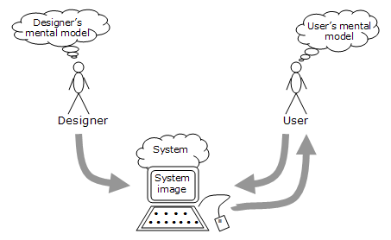
Building mental models
Image source: Mental models | The Glossary of Human Computer Interaction (interaction-design.org), adapted from Norman, 1988
Notes:
Important points:
Designer has their own model – may not match users. They may not understand or even know about the user’s.
Designer may be younger, more technically competent, more experienced than users. NNGroup mantra: you are not your user.
The way their model is communicated to user is via the system.
Designer needs to develop a MM that is appropriate for the user – and is understandable.
The designer and user only communicate through the system.

Slide 16
Supporting mental models
Make conceptual model of the system explicit or “transparent”​
Mayhew (1992) suggests​
Making invisible parts and processes visible to the user​
Providing feedback​
Building in consistency​
Presenting functionality through a familiar metaphor

Slide 17
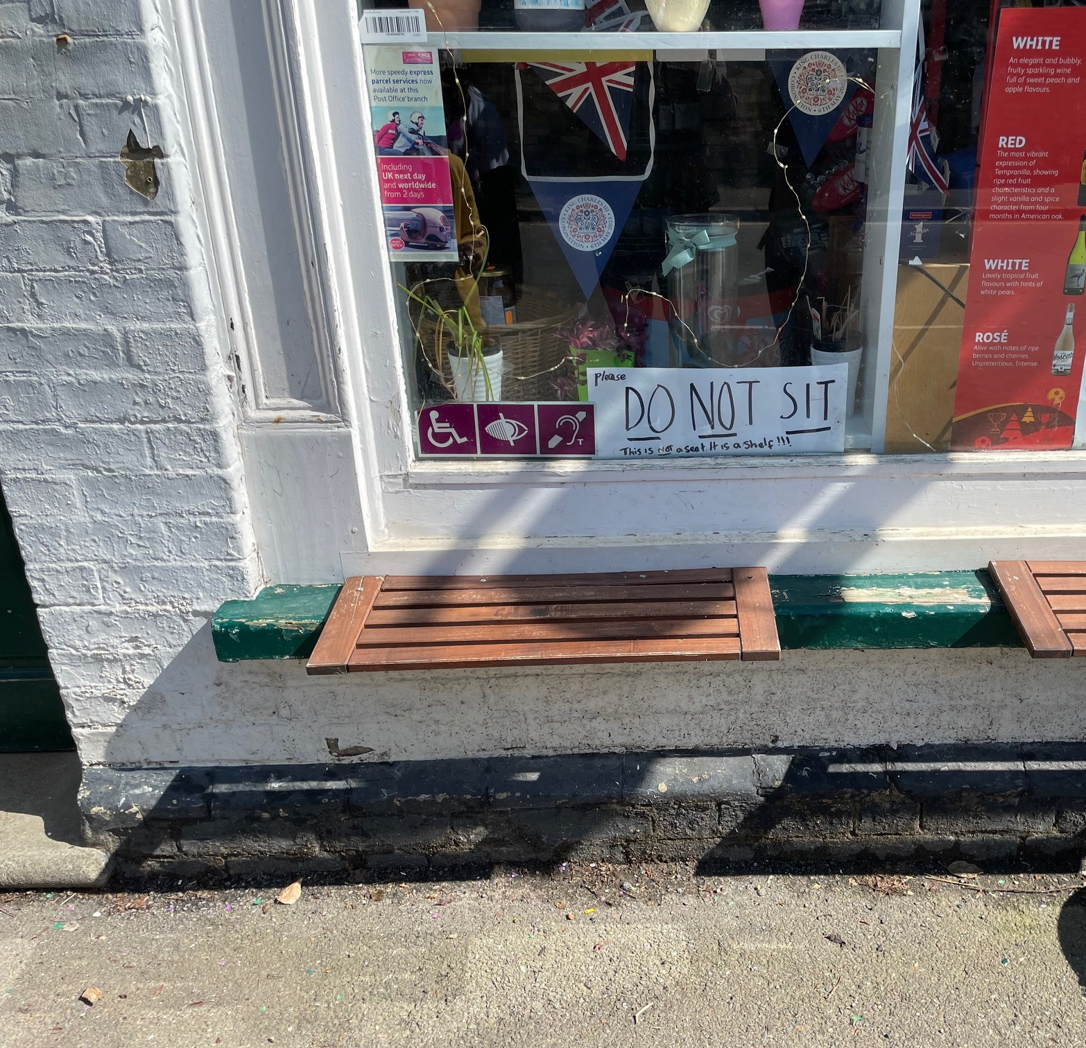
Design to support mental models slide 1 of 2
User’s understanding of how an object works​
Cues​
Explicit labels that denote interactive parts of an object, and (sometimes) how to use it​
Affordances​
Perceived and actual properties of an object that determine how an item could be used​
Influencing affordances?​
1. Follow conventional usage, both in the choice of images and the allowable interactions​
2. Use metaphor​
3. Follow a coherent conceptual model so that once part of the interface is learned, the same principles apply to other parts.​
Affordance fail!
Notes:
Cues: click here, add to cart, check out
Affordances: door handle push pull
Metaphor: e.g. save, file folders, delete bin, email envelope
Pt 4: remember that you bring your experience to the current interaction.

Slide 18
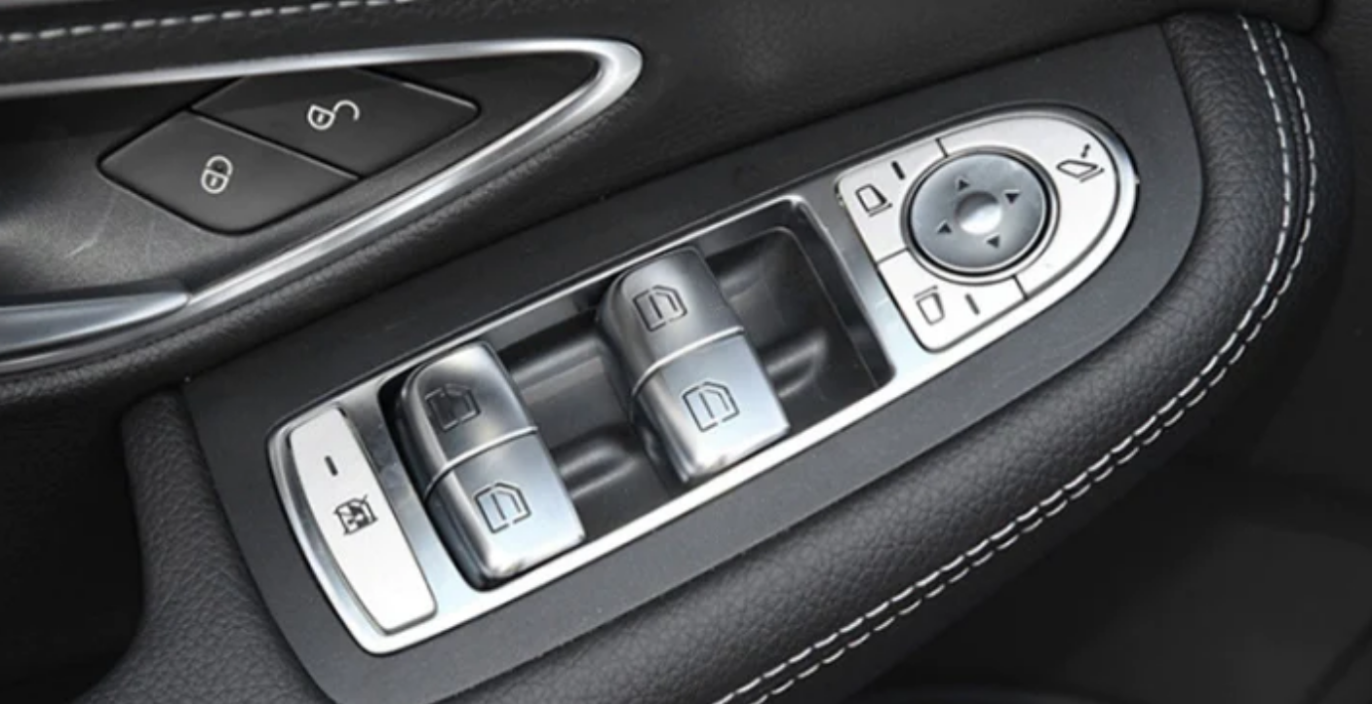
Design to support mental models slide 2 of 2
User’s understanding of how an object works​
Constraints​
Natural, physical constraints​
Constraints on the way in which an object or part can be moved, how it fits to other objects etc. e.g. the direction of thread on a screw​
Semantic constraints​
Cues based on knowledge of the meaning of a situation, e.g. knowing that if a pen lid is to prevent ink drying out, it will be placed over the part of the pen where the ink is exposed​
Cultural constraints​
Cues based on social conventions e.g. the order of lights on a traffic light​
Logical constraints​
Cues based on a logical relationship between the spatial or functional layout of components e.g. the last of switch options when functions of all others known​
Mappings​
The relationship between two things, such as controls and their movements and results in the world, e.g. steering wheel​…an extension of stimulus/response compatibility…
Image source: Car Auto Electronic Window Master Control Switch Button for Mercedes-Benz C Class W205 2015-2021 (Black) | UK | buy2fix
Notes:
Which window lift switch lifts the front left window? It’s because of mapping

Slide 19
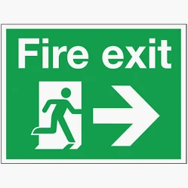
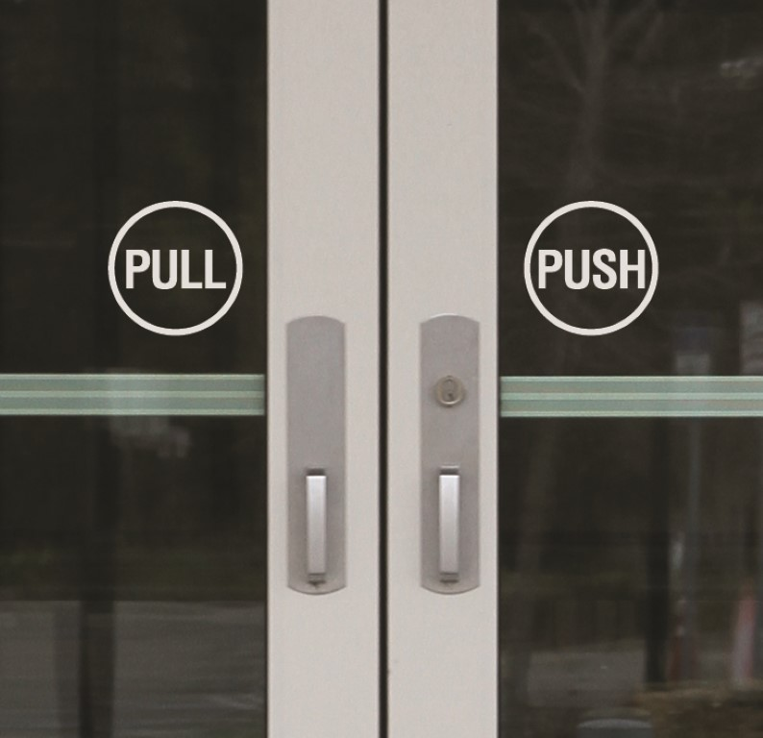
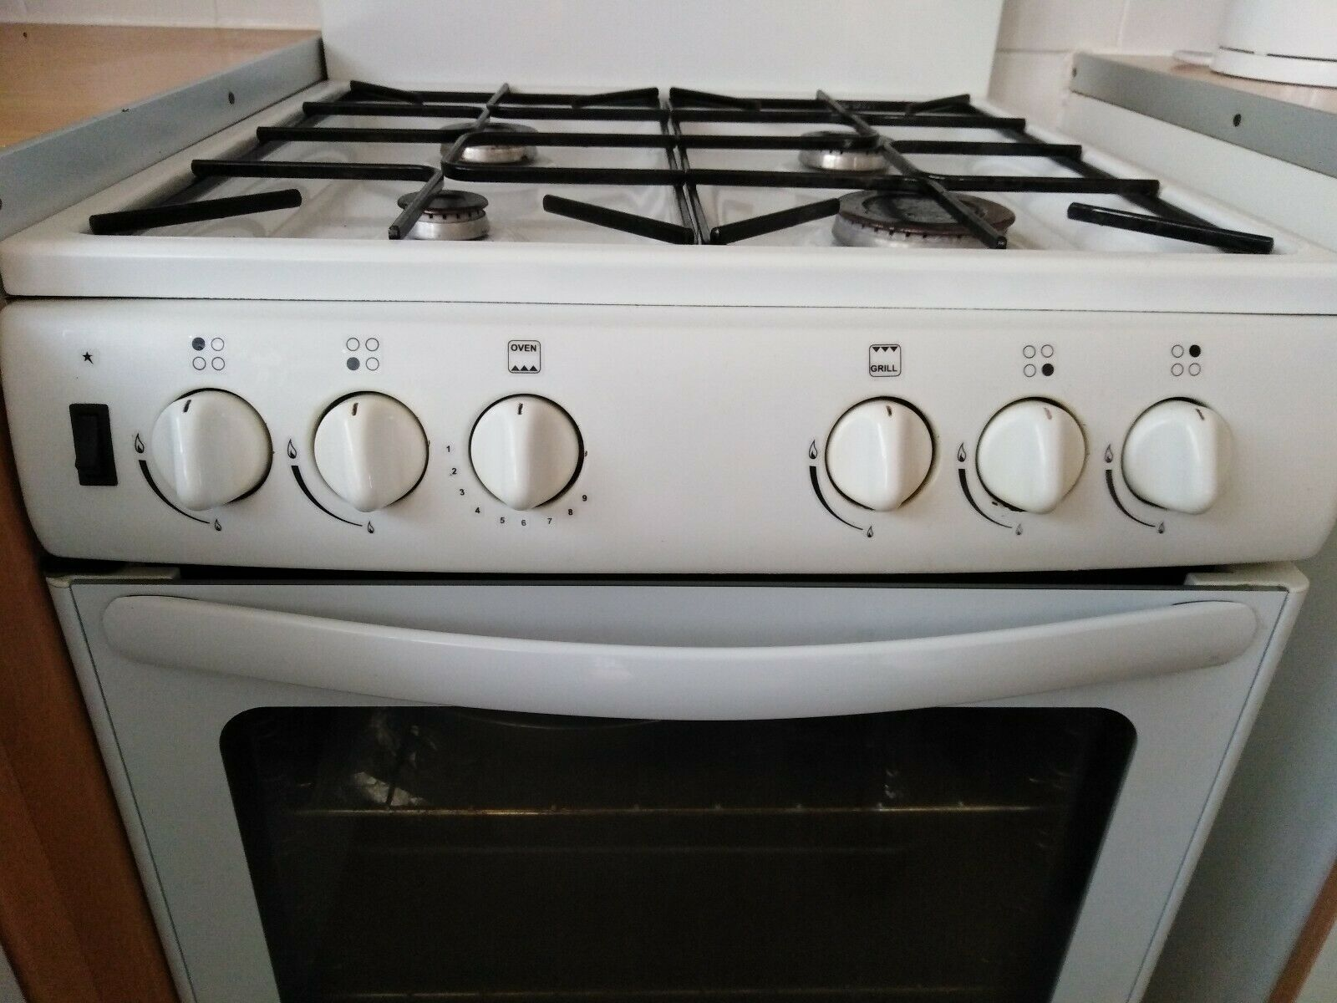

Cues
Notes:
Which window lift switch lifts the front left window? It’s because of mapping

Slide 20
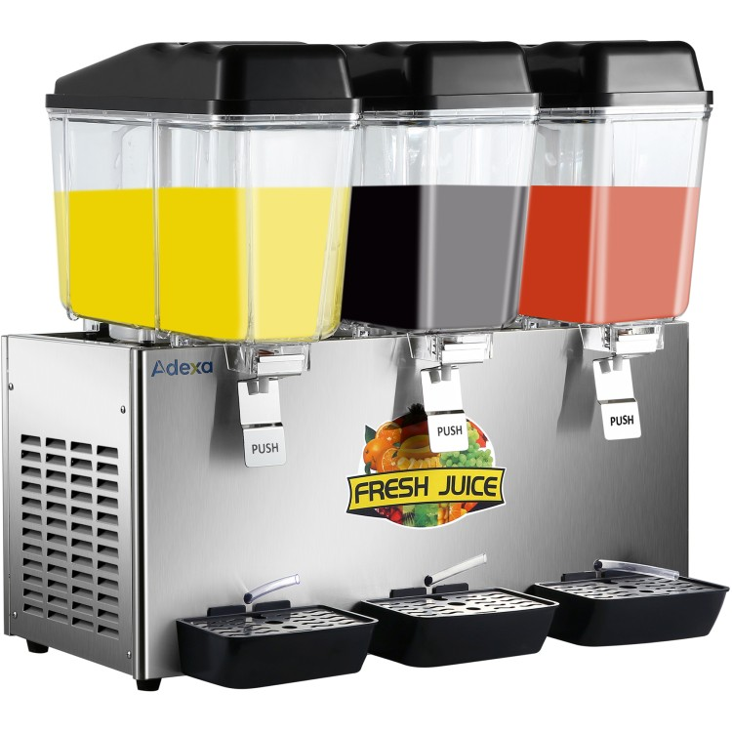

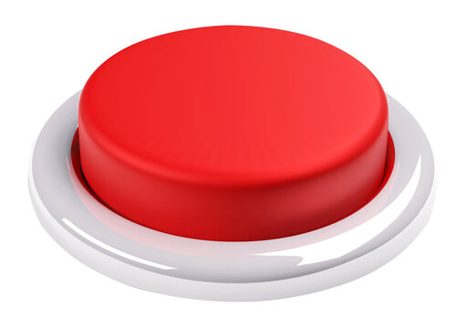
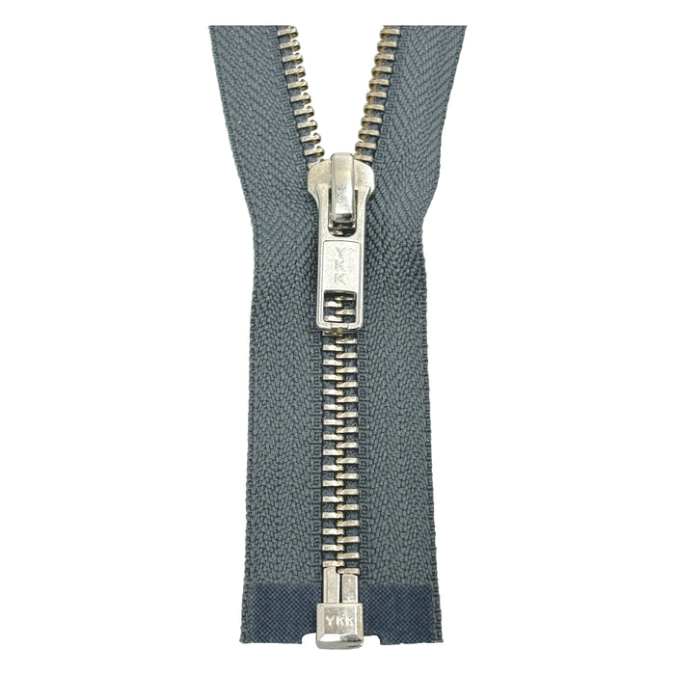
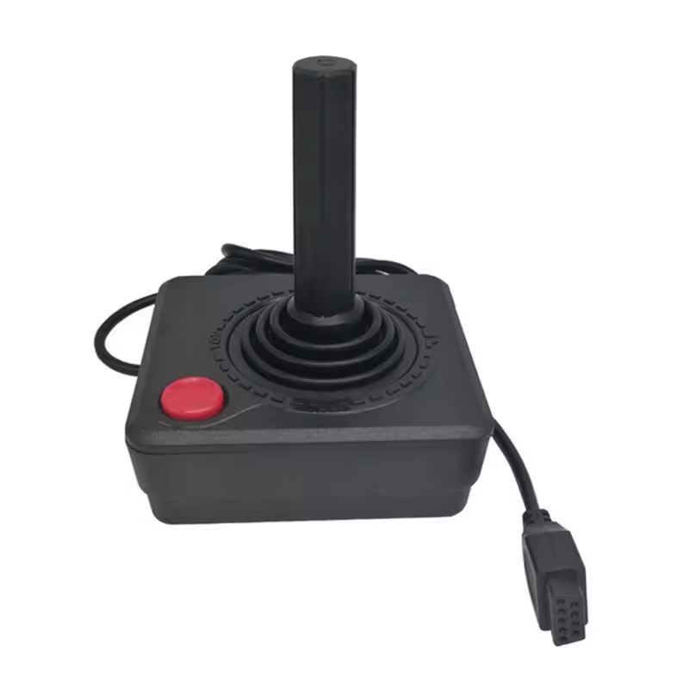
Affordances
Notes:
Which window lift switch lifts the front left window? It’s because of mapping

Slide 21
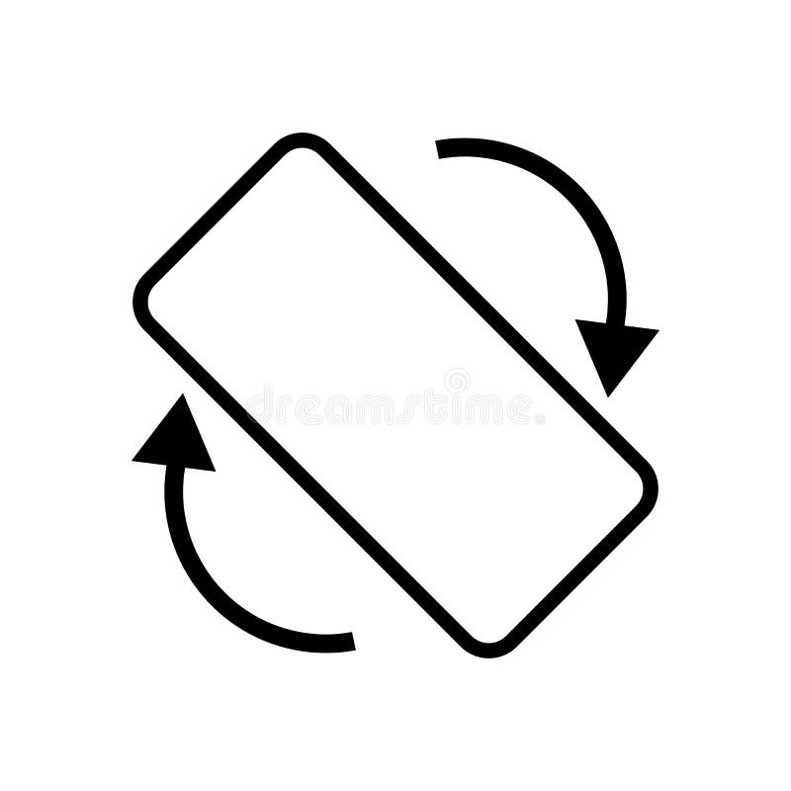

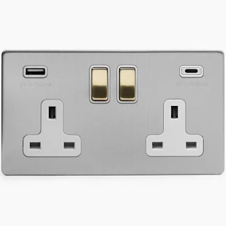



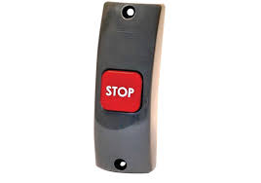


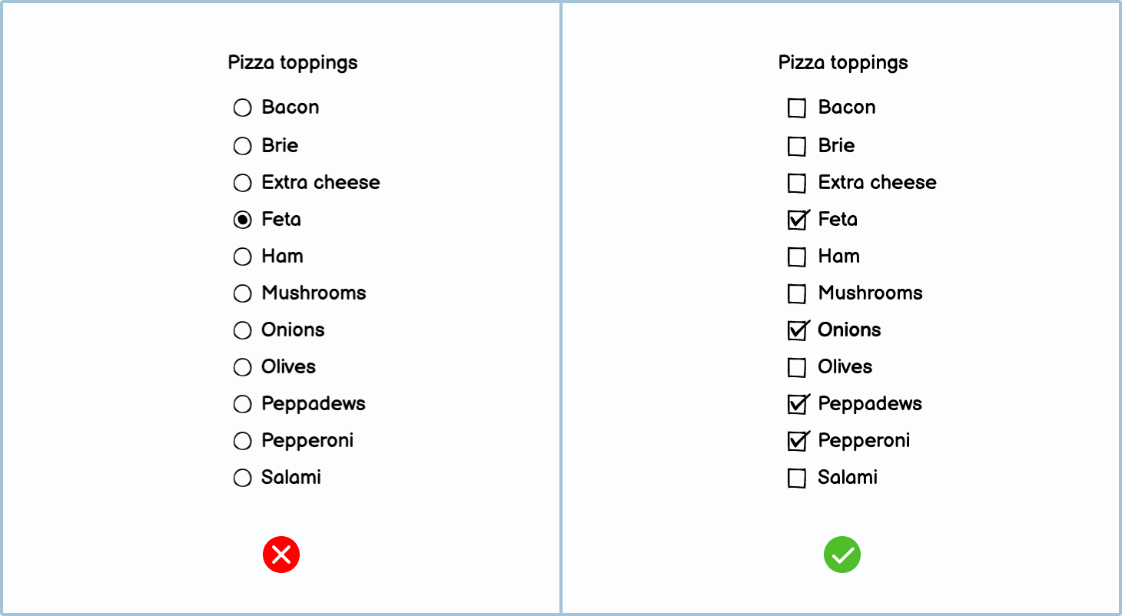
Constraints
Natural / Physical
Semantic
Logical
Cultural
Notes:
Which window lift switch lifts the front left window? It’s because of mapping

Slide 22
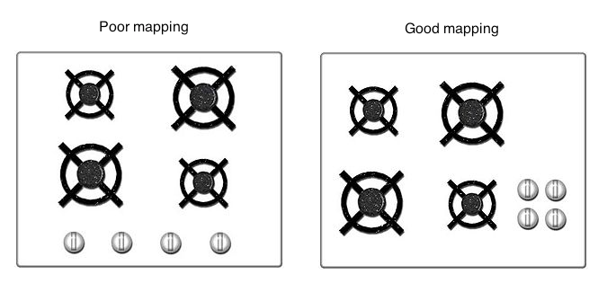
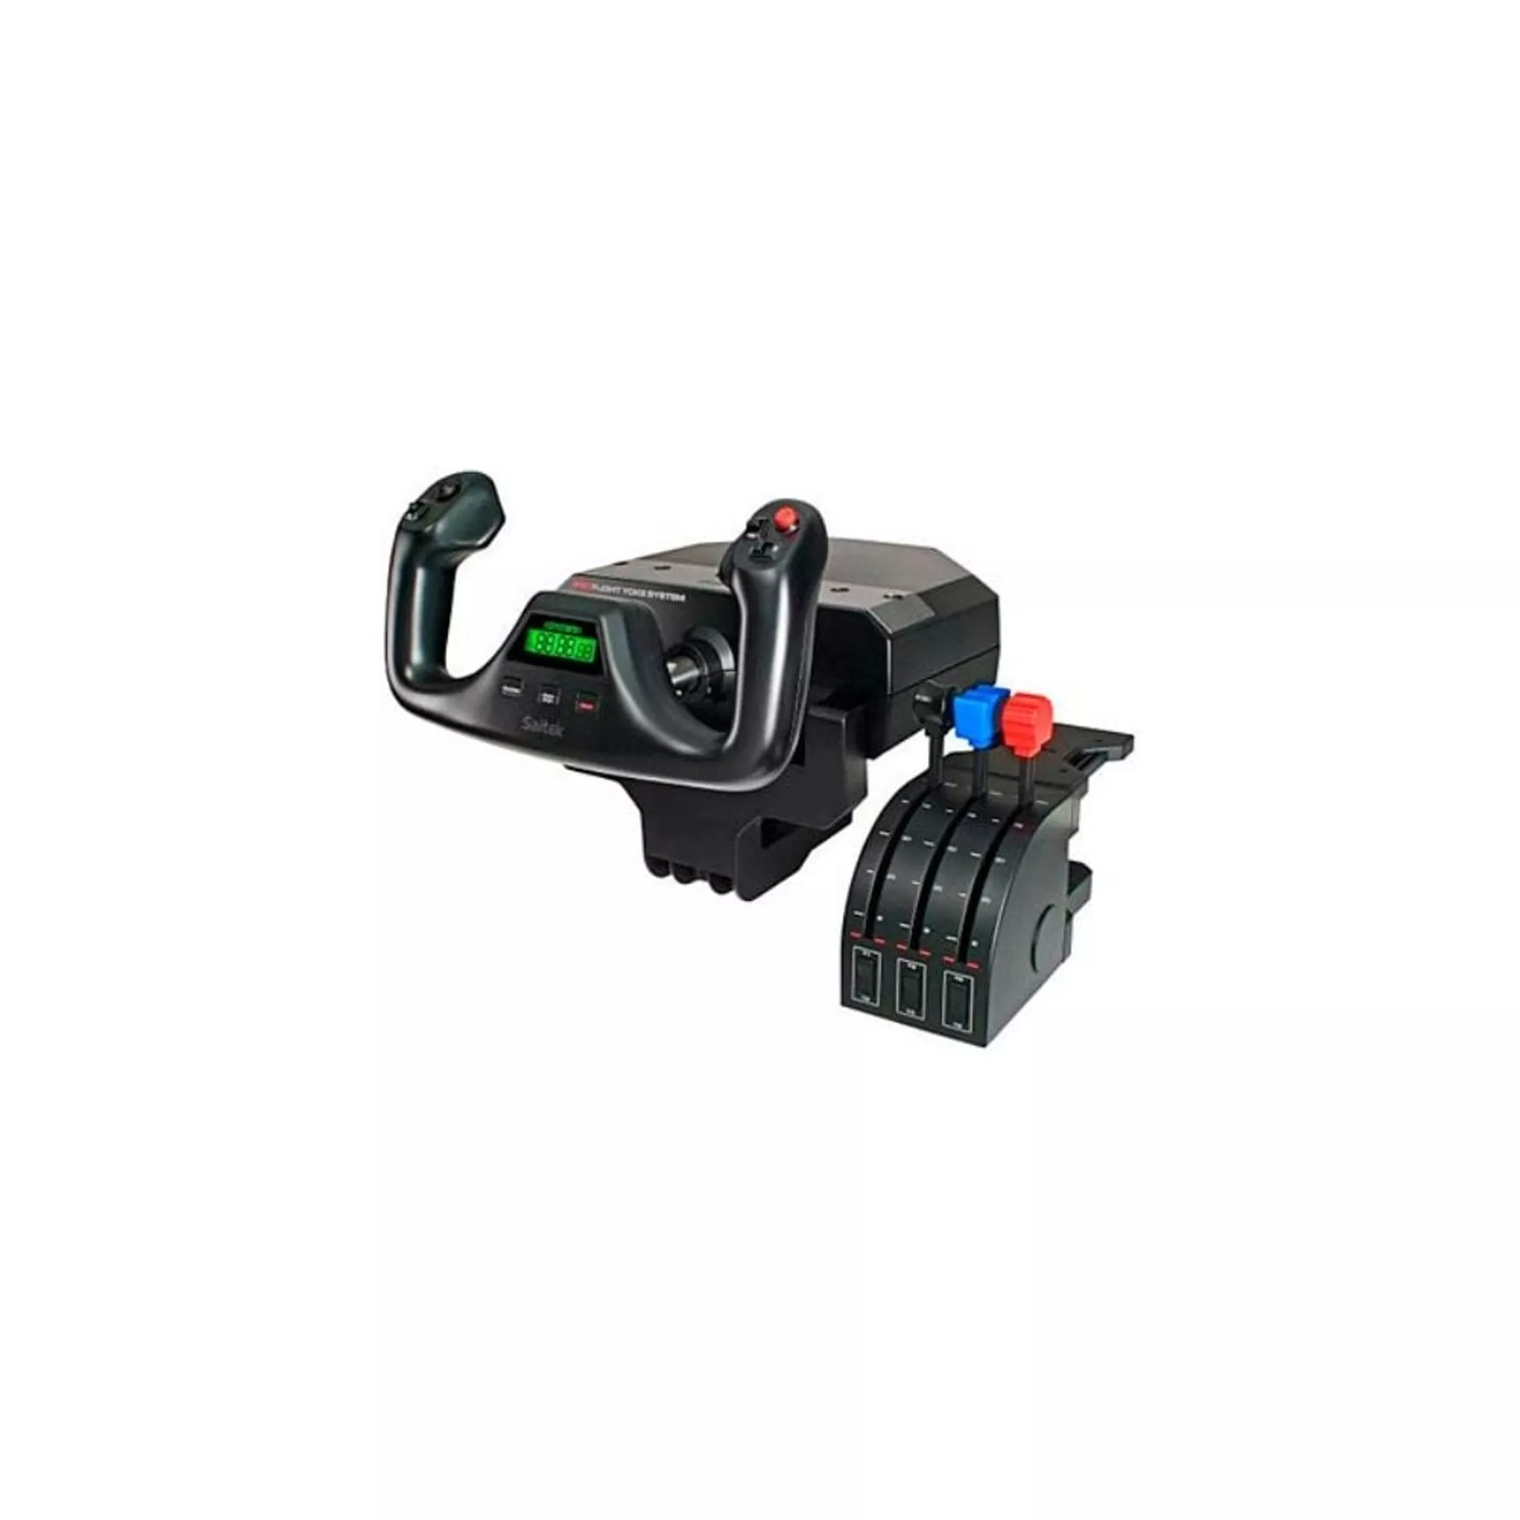
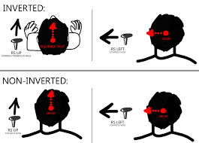
Mapping
Notes:
Which window lift switch lifts the front left window? It’s because of mapping

Slide 23
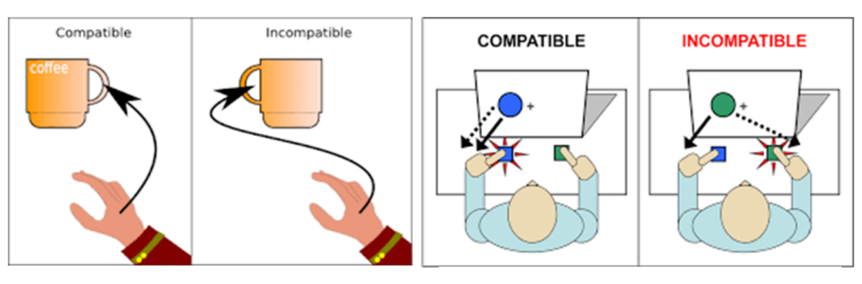
Stimulus Response compatibility
Extent to which perception of interface matches the required action
Image source: Ambient Cues of Kitchen Counter in Guiding Cooking Activities for Alzheimer's Patient | IEEE Conference Publication | IEEE Xplore
Notes:
Light switches – bottom on (opposite in US)
Clockwise increase
Forwards increase
Up increase
Issue: ipad volume button in landscape

Slide 24
Activity:
See if you can find an example of each of the design “tools” below on any kind of product – please ping the image to our teams page and mention whether it illustrates a cue, affordance, constraint, or mapping:
Cue
Affordances
Constraints​
Mappings
ACTIVITY!!!!
Notes:
Cue: labels
Affordances: properties of an object that determine how it should be used
Constraints: restrictions on how an object can be used based on physical constraint, meaning, culture or logic
Mappings: item maps to real world

Slide 25
Mental models
Let’s talk about designer’s assumptions – are they always accurate?!
Think about an example of a mental model you have which is incorrect (or otherwise interesting!)
Notes:
How could we improve this?
Cue – label
Training
Change design (by educating designer)
{bicycles are usually fairly transparent – easy to see the components so easy to develop MM – our MM tend to be more complete and accurate for simple and transparent objects than more complex/not transparent – we can understand causal relationships on simple/transparent. When things are hidden, we have to hypothesise)

Slide 26
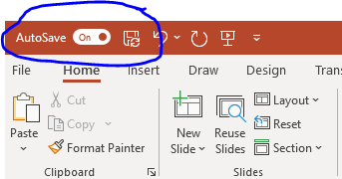
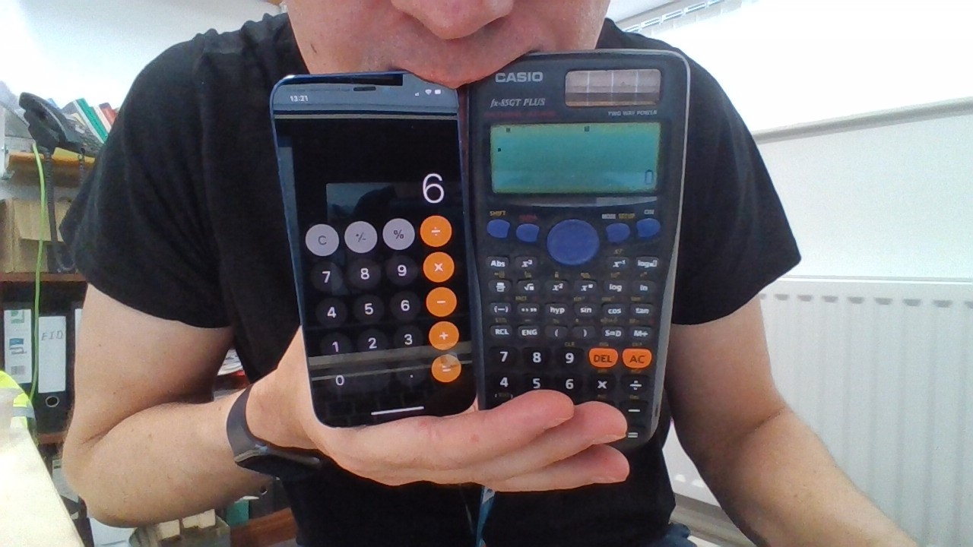
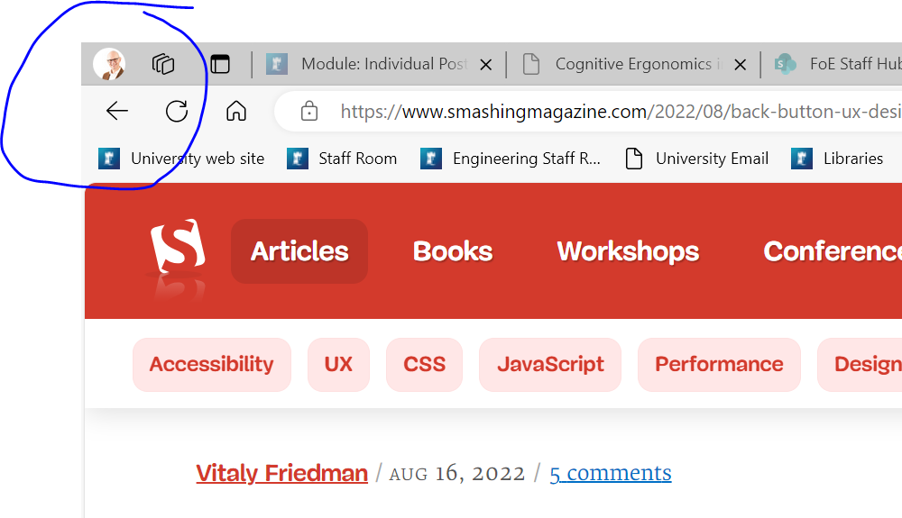
Activity – mental models
Can anyone think of examples where the designer’s mental model does or does not match the user’s mental model?
For example:
Home thermostat
File save / autosave
Back button
Calculator
ACTIVITY!!!!
Notes:
Save: “autosave” is disconcerting – especially when there is no option to click save (as our mental model is to hit save). Also, floppy disc was a nice image when we used floppy discs, but it’s still okay as it’s consistent and people have learnt that this means save – they bring their experience on all software to your software.
Back button – does it always go back to the previous page? Not necessarily if you’re in the middle of a transaction…

Slide 27
Skill, rule and Knowledge based behaviour (Rasmussen)​
Skills​
Sensorimotor performance which takes places as (more or less) automatic behaviour after a statement of intention​
e.g. Riding a bicycle​, typing, guitar (familiar piece)
Rules​
Goal-oriented performance controlled by a stored rule or procedure. The rule may have been derived from past experience or learned from other people’s experience​
e.g. Interpreting and acting upon familiar road signs​
Knowledge​
Goal-controlled or model-based behaviour used during unfamiliar situations. A plan is developed using knowledge, reasoning and experience to predict the outcome of actions​
e.g. Navigating in an unfamiliar environment

Slide 28
Exercise – SRK
Are the following examples of Skill, Rule, or Knowledge based behaviour?
Riding a bike
Driving a car (as an experienced driver)
Doing algebra
Completing your Cognitive Ergonomics in Design coursework (!)
Typing
Evacuating a building when the fire alarm sounds
Working out where to get a bus into Nottingham City Centre
Notes:
Several of them are mixtures and/or depend on expertise.
Riding a bike – skill
Driving a car (as an experienced driver) – skill, but also rule
Doing algebra - knowledge
Completing your Cognitive Ergonomics in Design coursework (!) -knowledge
Typing - skill
Evacuating a building when the fire alarm sounds - rule
Working out where to get a bus into Nottingham City Centre - knowledge

Slide 29
Knowledge in the head and knowledge in the world (Norman)
Not all knowledge required for precise behaviour has to be in the head.​
Distributed – partly in the head, partly in the world, and partly in the constraints of the world​
Precise behaviour can result from imprecise knowledge because:​
Information is in the world​
Great precision is not required​
Natural constraints are present​
Cultural constraints are present
Notes:
Human memory is limited.
Info in the world, e.g. signs, instructions, recognisable objects.
Cultural constraint: you stop at red light

Slide 30
Knowledge in the head and knowledge in the world (Norman, 1988)
Property​ | Knowledge in the world​ | Knowledge in the head​
Retrievability​ | Retrievable whenever visible or audible​ | Not readily retrievable. Required memory search or reminding​
Learning​ | Learning not required. Interpretation substitutes for learning​ | Requires learning, which can be easier if there is meaning or structure to the material​
Efficiency of use​ | Tends to be slowed up by the need to find and interpret the external information​ | Can be very efficient​
Ease of use at first encounter​ | High​ | Low​
Aesthetics​ | Can be unaesthetic and inelegant, can lead to clutter​ | Nothing needs to be visible, which can lead to better aesthetics​
Notes:
Need to think:– is there enough of each to support successful task completion?

Slide 31
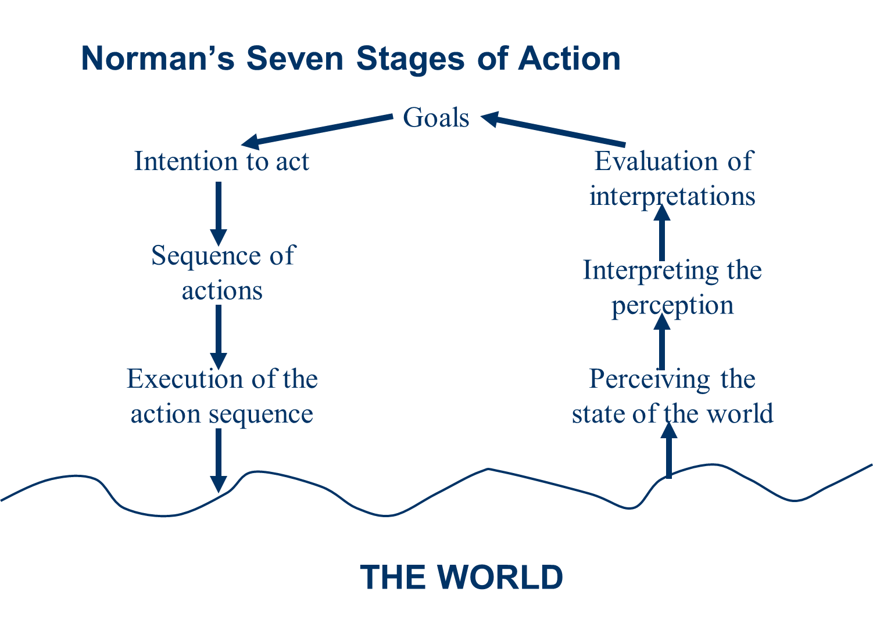
Norman’s Seven Stages of Action
Notes:
Norman’s seven stages – highlights when designer’s mental model doesn’t match the user’s mental model
Start at goals (not the world)

Slide 32
Gestalt laws of perceptual organisation - proximity
Proximity
Notes:
Gestalt principles are based on the idea that humans try to simplify and organise complex images or designs, but arranging the parts into organised system. We are built to see structure and patterns to help us understand the environment.
We perceive close objects as groups, e.g. this is three groups (not eight dots)

Slide 33
Gestalt laws of perceptual organisation - similarity
Similarity
Notes:
We group things that are similar, e.g. triangles and circles (not six individual objects)

Slide 34
Gestalt laws of perceptual organisation - closure
Closure
Notes:
We’ll close off incomplete objects

Slide 35
Gestalt laws of perceptual organisation - continuity
Continuity
Notes:
We see continuity in designs

Slide 36
Gestalt laws of perceptual organisation - symmetry
Symmetry and order
Notes:
Brain tries to simplify shapes. Will perceive symmetrical elements as part of a unified groups. See’s order in complexity.

Slide 37
Activity – Gestalt principles
Reminder of the Gestalt principles of design:
Similarity
Continuation
Closure
Proximity
Symmetry
(Figure/ground)
Let’s look at some logos – see if you can spot the Gestalt principle…
ACTIVITY!!!!
Notes:
Figure ground – brain distinguishes between objects in foreground vs. background.

Slide 38

Exercise – Gestalt principles 1
Image source: Pittsburgh Zoo & PPG Aquarium |
Notes:
Figure ground

Slide 39

Exercise – Gestalt principles 2
Image source: FedEx United Kingdom
Notes:
Closure – we “close” off the E/X to see the arrow (also possibly figure/ground)
Similarity: “Fed” and “Ex”

Slide 40

Exercise – Gestalt principles 3
Image source: WWF
Notes:
Closure – we perceive the animal as compete

Slide 41

Exercise – Gestalt principles 4
Image source: Olympic Rings - Symbol of the Olympic Movement (olympics.com)
Notes:
Is actually symmetry and order, in that it see order as 5 rings. But also, closure – untrained eye reads this as series of curves, but we see five rings.

Slide 42

Exercise – Gestalt principles 5
Image source: Unilever
Notes:
proximity

Slide 43
Implications for design – Mental models
How we design mental models ​
What level of understanding of a system a user has (or wants to have) ​
Capturing mental models​
Remember basic cognitive principles when establishing good practice in design

Slide 44
Any questions? Kyle.Harrington@nottingham.ac.uk

